Slide 1
Subject: Electricity Laboratory
Experiement 2: The ratio between lamp power
Al-Karkh University of Science
College of Science
Department of Medical Physics
Prepared by:
Dr. Nihad K Ali
Zaineb Faleh Nazal

Slide 2
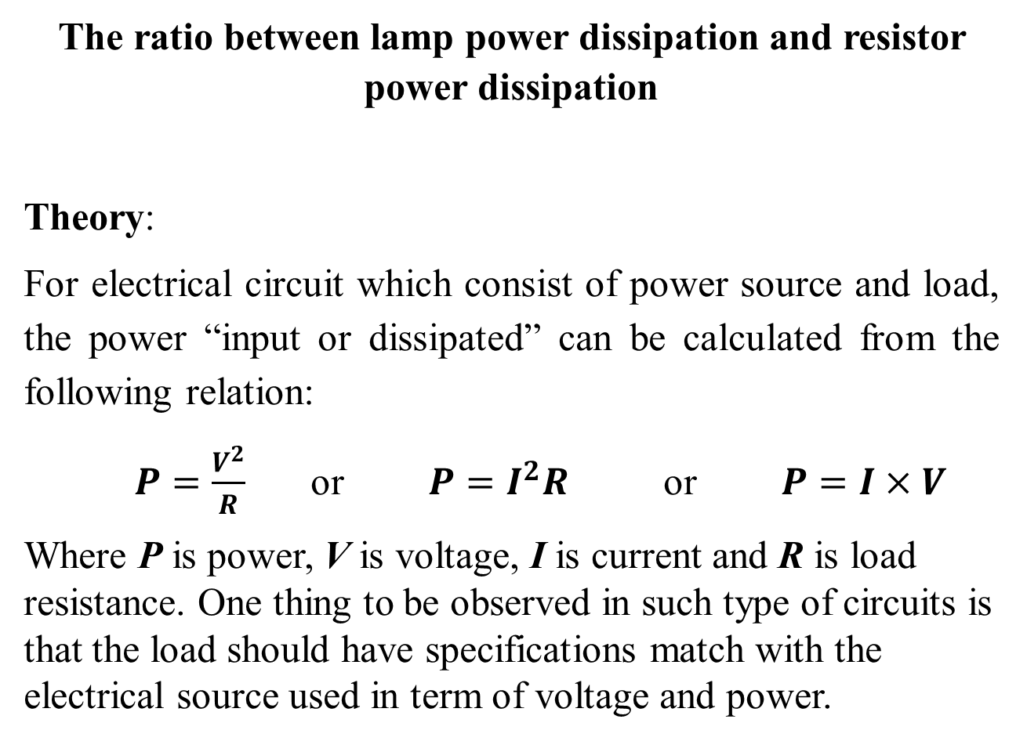
The ratio between lamp power dissipation and resistor power dissipation
Theory:
For electrical circuit which consist of power source and load, the power “input or dissipated” can be calculated from the following relation:
$P=\frac{V^{2}}{R}$ or $P=I^{2}R$ or $P=I×V$
Where P is power, V is voltage, I is current and R is load resistance. One thing to be observed in such type of circuits is that the load should have specifications match with the electrical source used in term of voltage and power.

Slide 3
Objective of the experiment:
This can be calculated by dividing the voltage on the resistor value. The circuit resistance will dissipate an amount of power from the input power:
P_{in} = P_{L} + P_{R}
Where P_{in} the input power, P_{L} is the power dissipated by the lamp, and P_{R} is the power dissipated by the resistor.

Slide 4
Instruments:
DC power supply.
Lamp.
Voltmeter.
Ammeter.
Resistors box.
Connection wires.

Slide 5
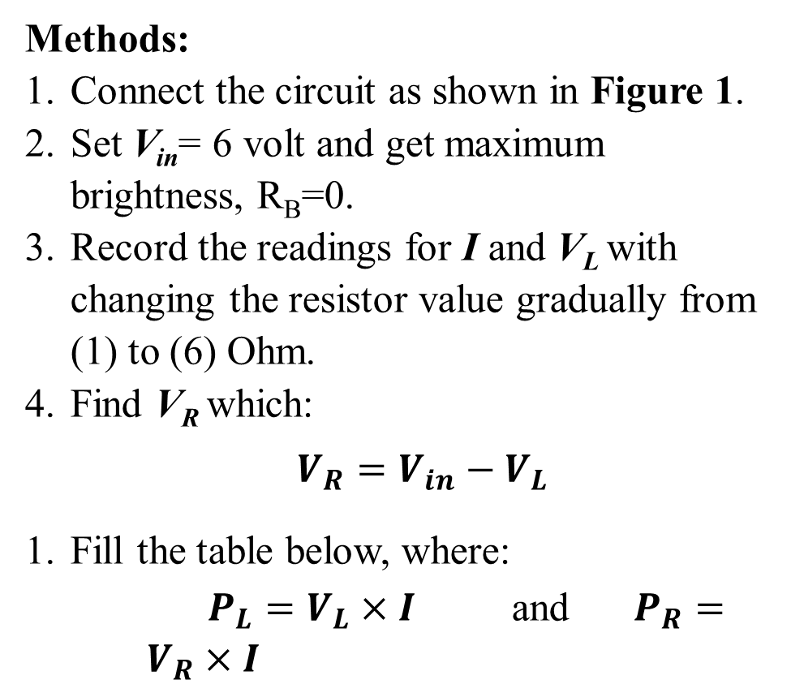
Methods:
Connect the circuit as shown in Figure 1.
Set V_{in}= 6 volt and get maximum brightness, R_{B}=0.
Record the readings for I and V_{L} with changing the resistor value gradually from (1) to (6) Ohm.
Find V_{R} which:
$V_{R}=V_{in}−V_{L}$
Fill the table below, where:
$P_{L}=V_{L}×I$ and $P_{R}=V_{R}×I$

